Slide 1
CS 2520: Wide Area Networks (and Internet Services)
Lecture 1: Introduction
Dr. Amy Babay, Fall 2021

Slide 2
Today’s Objectives
Understand course logistics and expectations
Build/review context for the rest of the course:
How are computer networks organized?
What does the Internet look like?
What are some of the fundamental challenges in networking?

Slide 3
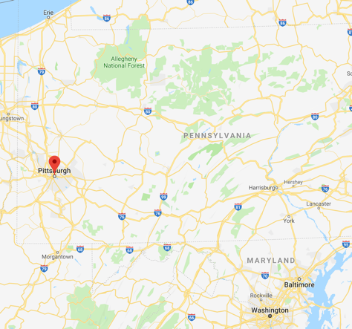
Introductions
Instructor: Amy Babay
PhD from Johns Hopkins University in 2018
“Timely, Reliable, and Cost-Effective Internet Transport using Structured Overlay Networks”: how can we provide the network performance needed for highly interactive applications?
Intrusion-tolerant SCADA for the power grid: how can we build computer systems that continue to work correctly despite compromises and network attacks?
Brief time in industry
Exploring commercial applications of PhD work
Infrastructure to simplify management of global overlay networks
Joined Pitt SCI in August 2019
Continue research on how to support a new generation of Internet services
Work with awesome students!

Slide 4
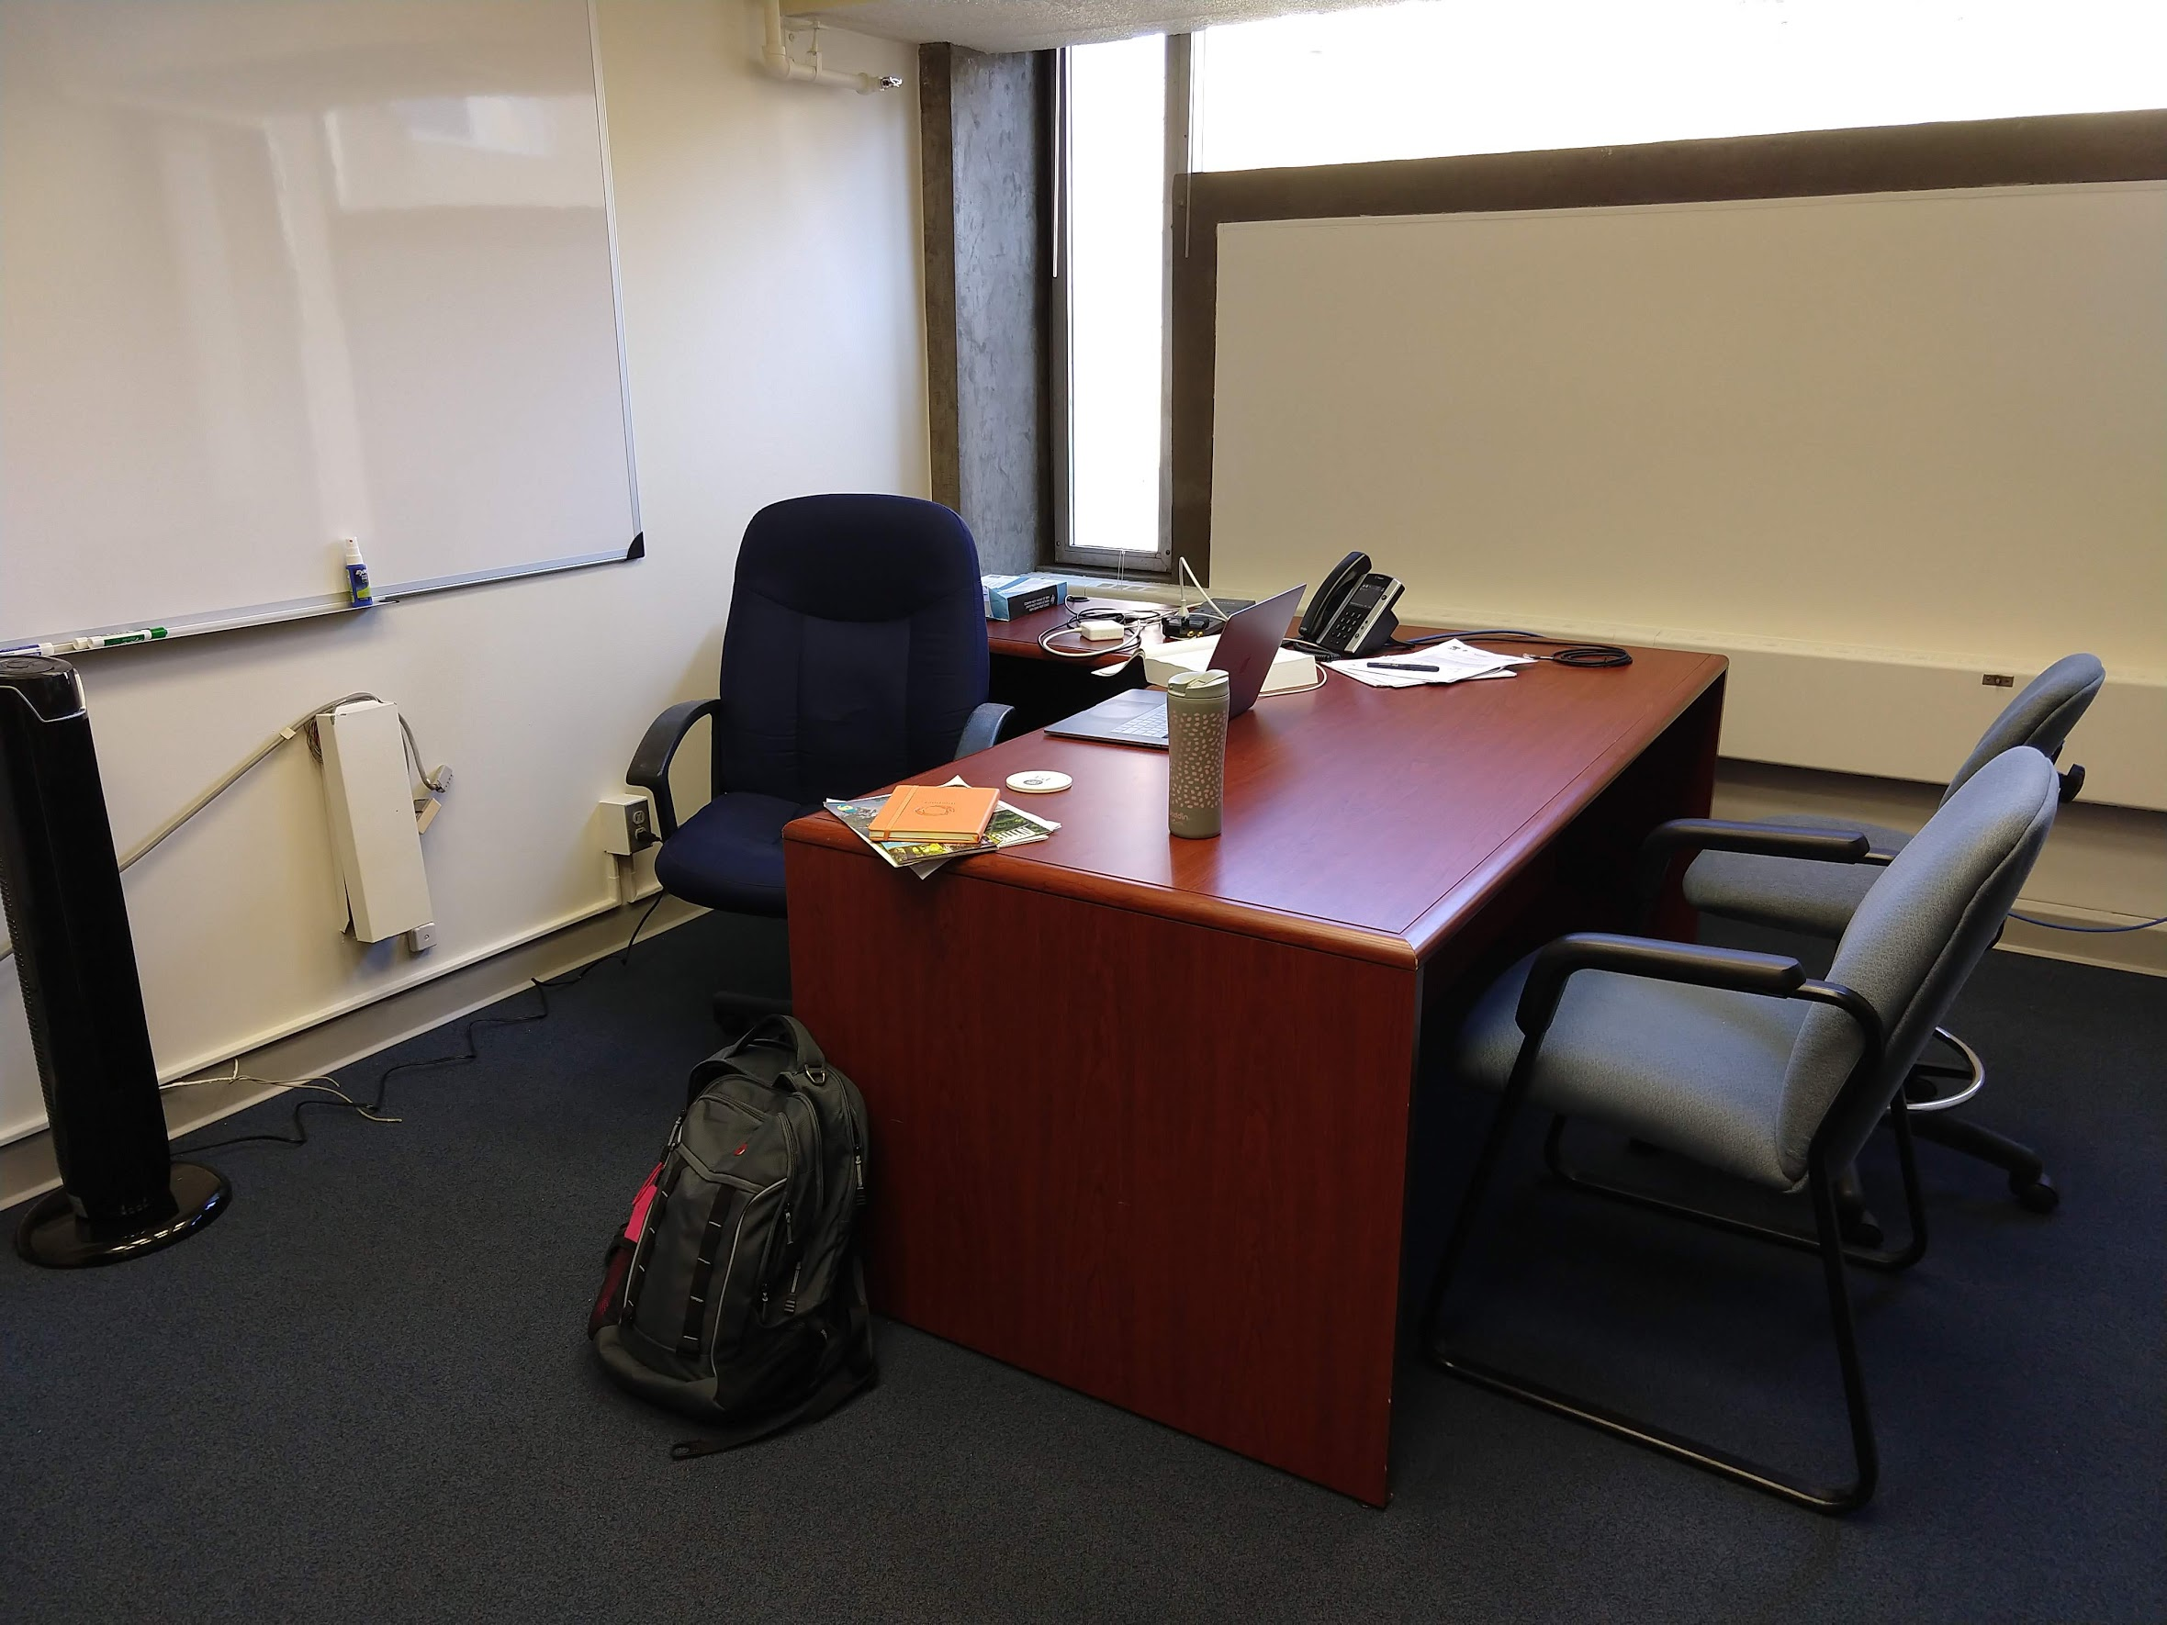
Introductions
Instructor: Amy Babay
Contact: Slack is best for quick response, or email babay@pitt.edu
Office hours: 3:30-4:30pm Tuesdays, or by appointment (I’m usually pretty flexible and happy to meet).
TA: TBD
Contact: Slack or email TBD
My office: 701B IS Building

Slide 5
Course Logistics
Course Meetings:
4:30 – 5:45pm Mondays and Wednesdays, 5313 Sennott Square
Lectures, paper discussions, a few in-class labs (bring a laptop! Lab dates will be announced in advance)
Plan is for in-person meetings unless Pitt announces major changes
Canvas: slides, major announcements, assignments & submission
Schedule on Canvas is tentative
Slack: questions, discussion, fastest way to reach course staff outside normal class time…and you can help each other too
You should check Slack regularly as you work on the projects, since other students may ask questions that are useful for you too!

Slide 6
Prerequisites
C/C++ programming
Linux development tools and command line environment
ssh, scp, vim/emacs/nano, gcc, make
Some familiarity with computer networking
e.g. basic course (CS 1652 / INFSCI 1630 / TELCOM 2310)
textbook is highly recommended if you don’t have this background (or it’s been a while)

Slide 7
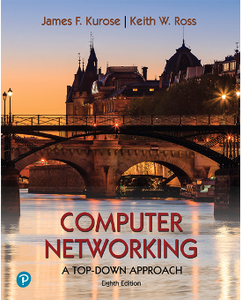
Textbook (optional)
“Computer Networking: A Top-Down Approach”, 8th edition. James Kurose and Keith Ross.
Earlier editions also fine

Slide 8
Workload and Grading
3 programming assignments (50%)
to be written in C/C++
need to run in LAN/cluster environment and wide area environment (GENI)
Final project (20%)
integrating concepts from the prior 3 programming assignments
~8 paper reviews (20%)
reviewing classic and recent research papers related to the topics we cover
in-class labs and participation (10%)
No exams ☺

Slide 9

Late Assignment Policy
Late assignments will not be accepted without prior approval from the instructor
But, I understand that valid extenuating circumstances come up…if you do have an issue, please tell me!
You will be able to submit assignments multiple times, with the last one received before the deadline being graded
We aren’t geologists; milliseconds matter ☺
https://xkcd.com/2187/

Slide 10
Academic Integrity Policy
Simple version: DO NOT cheat; if you aren’t 100% sure whether something is cheating, ASK ME
Giving your work to someone else is cheating
Minimum violation consequences: no credit for affected assignment, may be subject to further School or University-level action

Slide 11
Academic Integrity: Collaboration Policies
Programming assignments & Final project: to be completed in pairs (we can help with team formation)
limited collaboration with other groups is permitted
Discussing concepts is okay; discussing, sharing or looking at solutions or code is NOT okay
limited use of online/external resources is permitted
using Google or StackOverflow to figure out bugs/technical issues is okay; searching for solutions to the assignment or parts of it is NOT okay
looking at someone else’s code that solves the same / highly similar problem is NOT okay
If you are unsure, ask!
Paper reviews: to be completed individually
Cheating vs Collaboration: some nuance, but most cases of cheating are very clear
Often come from panicking to get something in before the deadline
Solution: Start early, ask questions (Slack or office hours) if you get stuck

Slide 12
Disability Resources
If you have a disability for which you are or may be requesting an accommodation, you are encouraged to contact both the instructor and Disability Resources and Services as early as possible in the term
http://www.studentaffairs.pitt.edu/drs/

Slide 13
Questions?

Slide 14
Now, on to networks…
Some slides are adapted from those created by the textbook authors: http://gaia.cs.umass.edu/kurose_ross/ppt.htm
with some additional inspiration from the Computer Networks course at Johns Hopkins

Slide 15
High-Level Course Goals
Understand how wide area computer networks, and particularly the Internet, work
Practice reasoning about and designing complicated systems
Build skills in implementing and evaluating networked systems
Gain exposure to state-of-the-art networking research

Slide 16
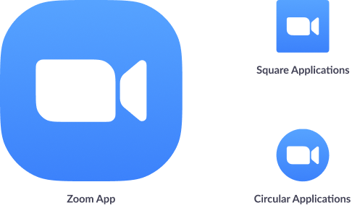

Motivation: Complex, Networked World

Slide 17
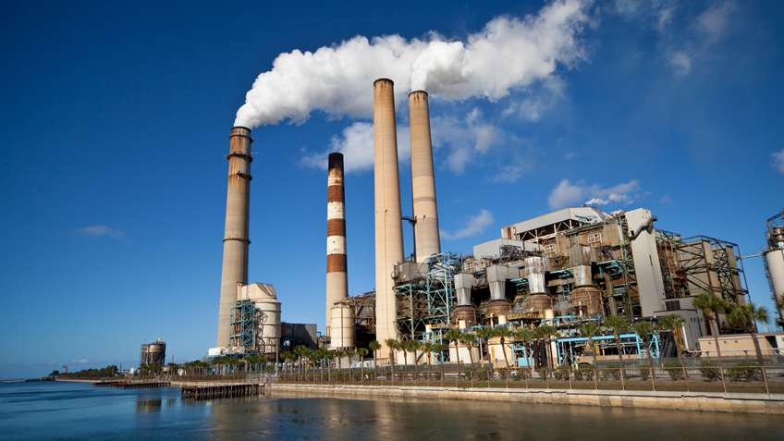

Motivation: Complex, Networked World

Slide 18
Motivation
Networks are a huge part of our lives today
Understanding how they work “under the hood” is a lot of fun!
Networking challenges come up in many other areas
Our world is only getting more complex and more connected
Ability to reason about complex systems and find simple abstractions will serve you well in anything you do
Despite the Internet’s amazing success, there is still a lot of room for innovation
New applications bring new demands; some require new network services

Slide 19
Approach
Study how the internet works today
transport, network, and link-layer protocols
compared to an introductory course: fewer specific topics in more depth, emphasis on recent/ongoing innovation
implement network protocols to get hands-on understanding of the fundamentals (e.g. reliable transport, real-time transport, routing)
Understand some of the limitations in how the internet works today
read recent research papers attempting to address some of these limitations
Understand some of the key challenges in building networked systems that run on top of the internet
study some principles of distributed systems

Slide 20
Warm-up: Reviewing the Terminology
Networks consist of links that connect nodes and can carry information between them
Many types of networks: computer networks, transportation networks, social networks

Slide 21
















Focusing on the Internet
mobile network
Nodes that we want to connect are called hosts or end systems
End systems connect to the Internet through Internet Service Provider (ISP) networks, which are (roughly) organized in a hierarchy
national or global ISP
Nodes are connected by packet switches…
local or regional ISP
…and communication links
Internet
home network
content
provider
network
Collections of nodes and links form networks
(that are interconnected with switches/routers and communication links)
datacenter
network
enterprise
network

Slide 22
Focusing on the Internet
Information gets packaged into chunks of data called packets, which traverse a particular path or route of links and switches to get from their sender to their receiver
mobile network
This data can come from any one of many different applications that run over the same network infrastructure (Web browsing, messaging, email, video-on-demand, teleconferencing, gaming…)
national or global ISP
local or regional ISP
Internet
home network
content
provider
network
Different communication links may have different transmission rates (bandwidth) -- measured in bits/second
datacenter
network
enterprise
network

Slide 23
What needs to happen to make this whole process work?
Raises some questions:
How does data get broken into packets? And put back together (reliably)?
How do we find a route from sender to receiver?
How do we find a good route? What does good mean here?
Do we need to know the structure of all the networks between them to do that?
Wait, how do I even find the host I want to send to?
How can many users and many different applications share network resources (fairly)?
How can diverse end systems and routers from many different manufacturers connected to networks operated by different providers communicate effectively?
How is data physically transmitted? What determines transmission rate?
and more…
Do we care about answering these questions?
Sometimes! This is what the course is about, after all…
But, not always, and usually not all at the same time

Slide 24


Creating Simplicity out of Complexity
Applications (or application developers) can look at the Internet as a “black-box” infrastructure that provides certain services
Applications access those services through well-defined interfaces
Not my problem!
Put letter in envelope, address it, specify services (express, receipt confirmation, etc)
Open envelope, take out letter, read it
Computer networks also use this approach internally, separating responsibilities into layers, with each layer providing services to the one above

Slide 25
Communication organization
L7
Application
Applications
are built on
Reliable or unreliable transport
L4
Transport
is built on
Best-effort global packet delivery
L3
Network
is built on
Best-effort local packet delivery
L2
Data link
is built on
Physical transfer of bits
L1
Physical

Slide 26
Communication organization: more detail
Application layer: all the services we (users) interact with
Transport layer: deliver application data from sending program to receiving program
Different semantics/services possible: best-effort (UDP) vs reliable (TCP). [what else might we want??]
Network layer: deliver packets from sending host to receiving host (best effort)
Routing: find a path (sequence of communication links and routers) through the network(s) from sending host to destination host
Link layer: deliver packets from one end of a communication link host/router to the other

Slide 27
Transport Layer Intro
Transport layer objective: provide logical communication between application processes
Abstracts out network details; applications can act as if directly connected
Different transport protocols can offer different services
On the Internet: UDP vs TCP
Built on top of network layer service
Provides best-effort (unreliable) communication between hosts
application
transport
network
data link
physical
mobile network
national or global ISP
logical end-end transport
local or regional ISP
home network
content
provider
network
application
transport
network
data link
physical
datacenter
network
enterprise
network

Slide 28
Network Layer Intro
Network layer objective: transport packet from sending to receiving host
Routers:
examine header fields in packets passing through them
move packets from input ports to output ports to transfer them along end-end path
mobile network
national or global ISP
application
transport
network
link
physical
network
link
physical
network
link
physical
network
link
physical
network
link
physical
network
link
physical
datacenter
network
application
transport
network
link
physical
enterprise
network

Slide 29
Link Layer Intro
mobile network
Link layer objective: transport from one node to another physically adjacent node over a link
Link: communication channel that connects adjacent nodes along communication path
wired
wireless
LANs
national or global ISP
datacenter
network
enterprise
network

Slide 30
Logical communication
A layer interacts with its peers corresponding layer
Application
Application
Transport
Transport
Network
Network
Network
Datalink
Datalink
Datalink
Physical
Physical
Physical
End system
Router
End system

Slide 31
Physical communication
Communication goes down to physical network
Then up to relevant layer
Application
Application
Transport
Transport
Network
Network
Network
Datalink
Datalink
Datalink
Physical
Physical
Physical
End system
Router
End system

Slide 32
Layer encapsulation: Protocol headers
User A
User B
HTTP
request/response
TCP header
IP header
Ethernet
header
Notes:
Deepest level most header

Slide 33

Course Roadmap
Today:
Setup context and vocabulary
A bit more on Internet structure
Main part: (Roughly) Moving down the protocol stack
Transport layer
Network layer
Link layer
Internet Services: Going back to the application layer
Based on what we’ve learned about the internet, we’ll investigate challenges and strategies for building reliable and scalable networked systems

Slide 34
Summary
You should now:
Understand what to expect from this course (and what I’ll expect from you)
Understand why we’re studying computer networks in general and the Internet in particular
Understand concepts of interfaces, layering, and protocols
Have a mental model of what the Internet looks like (i.e. the pieces it is made up of)
Hosts/end systems, packet switches (switches & routers), communication links
End systems (possibly part of home or enterprise networks), connect to access ISPs
For next class:
Join the Slack group
Join the GENI project
Start forming pairs for Project 1

